Slide 1


Inside of a Mouse’s Brain
Reducing Dimensions of Neural Recordings using Seq-to-Seq Modeling
Dimensional Data Diggers
Dimensional Data Diggers
Dimensional Data Diggers
July 2023

Slide 2
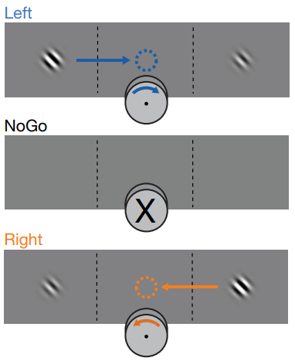
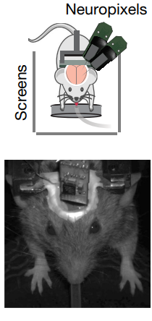
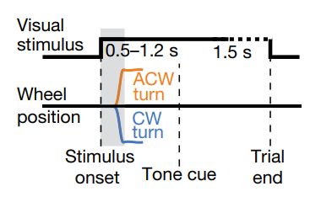
The experiment set-up
Neuropixels probes recorded approximately 30,000 neurons in 42 brain regions while performing a visual discrimination task.
Dimensional Data Diggers
Dimensional Data Diggers

Slide 3
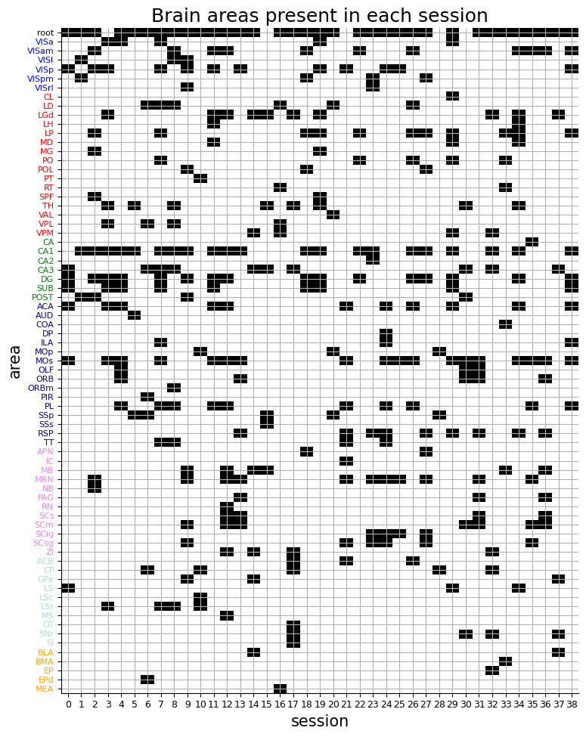
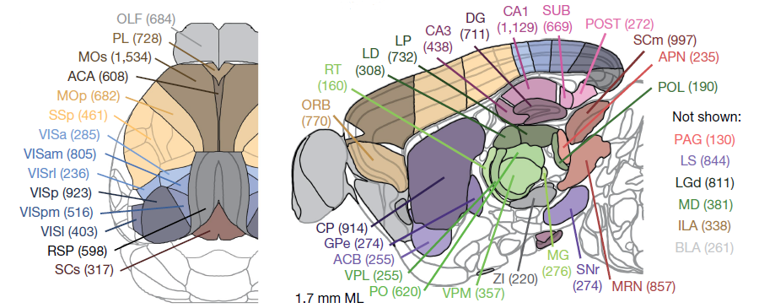
Recorded brain regions
Dimensional Data Diggers
Dimensional Data Diggers

Slide 4
Question
Goal
Can we find similarities in activities in different brain areas during a certain process?
Can activity of one area of the brain be predicted from activity of other areas?
Can activity of a subset of neurons be predicted by another subset in the same region?
Learning about brain connectivity;
Shedding light on how information from one brain area can be used to predict activity of another region
Dimensional Data Diggers
Dimensional Data Diggers

Slide 5
Project steps
What information does the dataset include?
Which variables should be modelled and considered?
ML network selection
Data analysis
Literature review
Model variables
Preprocess the input
Planning the model
How others approach similar questions/goals?
Make the input ready for modelling
Dimensional Data Diggers
Dimensional Data Diggers

Slide 6
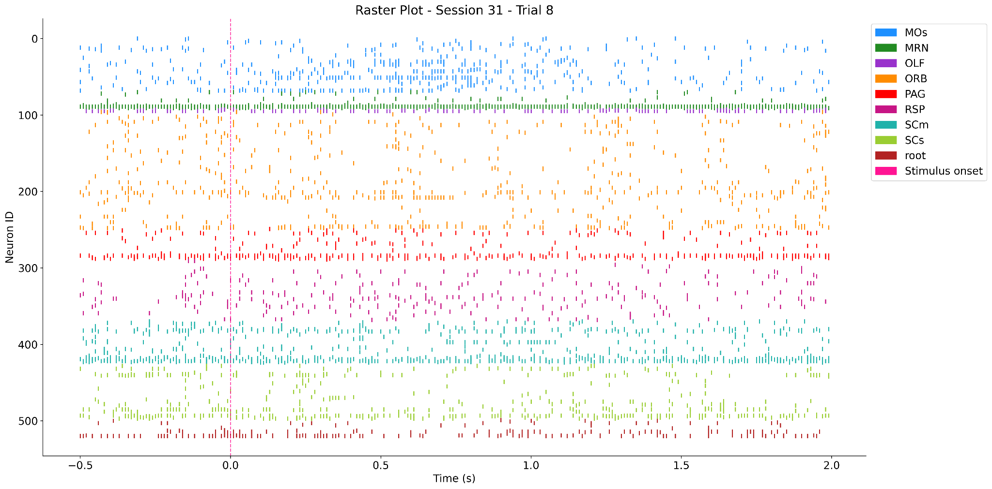
Raster plot for all neurons in session 31
Dimensional Data Diggers
Dimensional Data Diggers

Slide 7
Implementation Steps
RNN and LSTM training
Grid Search
Model Selection
Model
Loss function
NN model
Regularization
Tuning
Loss function choice (Poisson loss function)
Regularization methods testing
Dimensional Data Diggers
Dimensional Data Diggers

Slide 8
Model architecture
1-3 fully connected layers of RNN/LSTM
Input
Linear layer
Output
Time x NN1
NN1 x N_latents
N_latents x NN2
Time x NN2
Time: 250 time point, binned by 10 ms
NN1, NN2: number of neurons
Dimensional Data Diggers
Dimensional Data Diggers

Slide 9
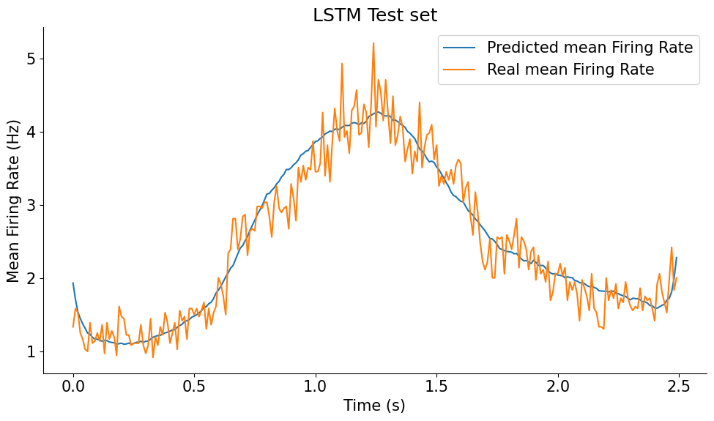
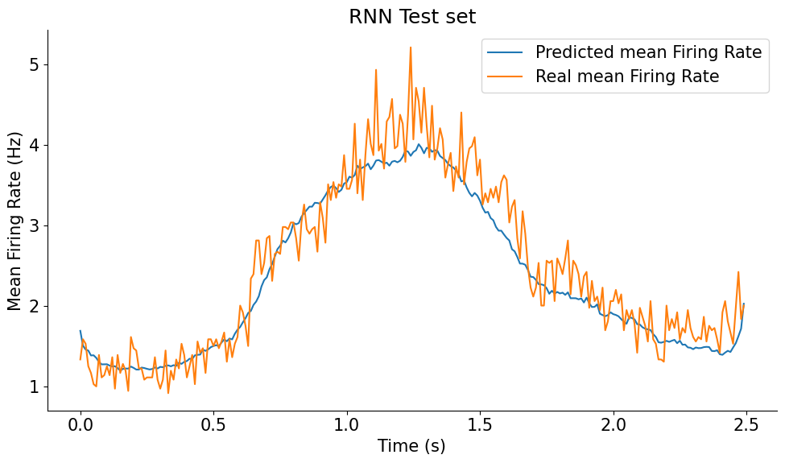
Predicting motor cortex based on other areas
Input: 453 other area neurons
Output: 69 motor cortex neurons
15 neurons in fully connected layer, tested on 20% of data
Learning rate 0.001; weight decay 0.0001
Poisson loss function value 0.0873
Poisson loss function value 0.0914
Dimensional Data Diggers

Slide 10
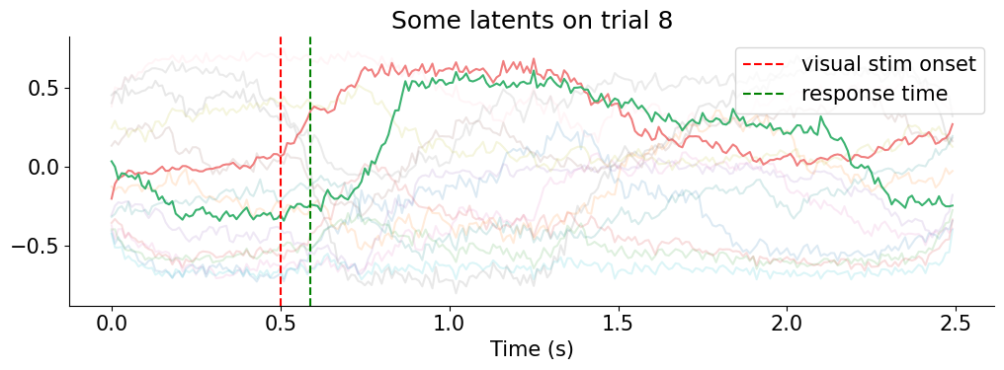
Plotting some latents of LSTM (2/15 latents)
Dimensional Data Diggers
Dimensional Data Diggers

Slide 11
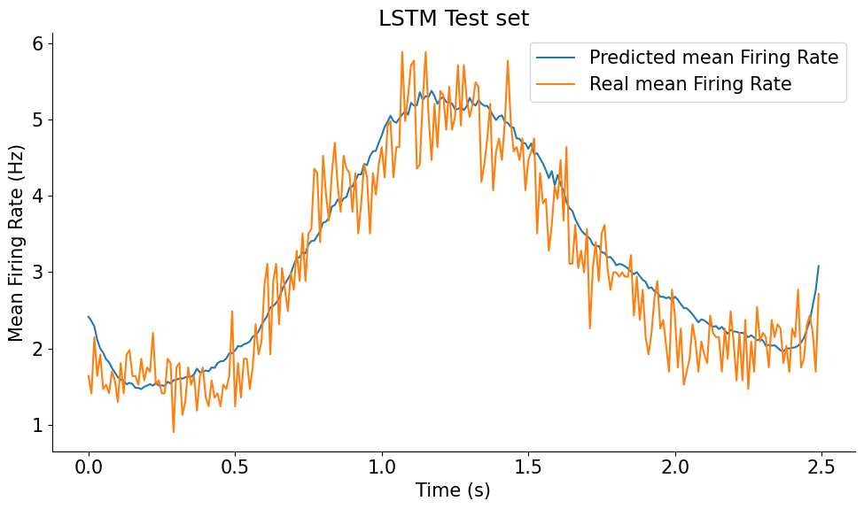
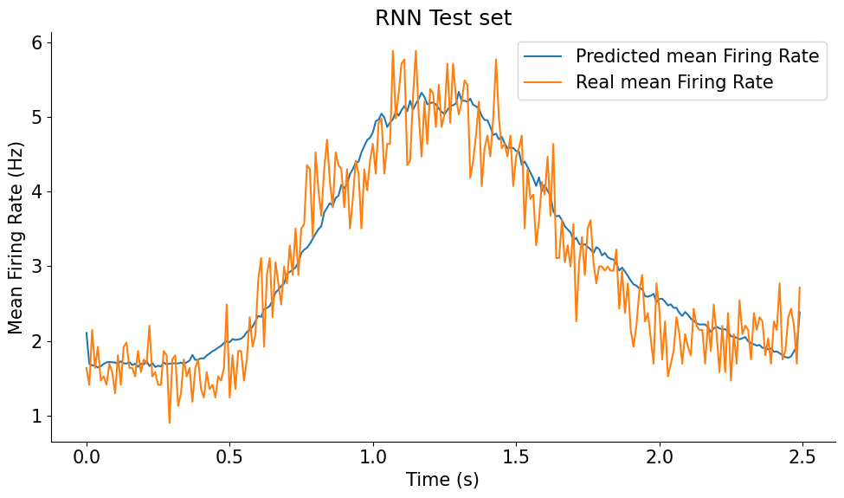
Predicting activity of MOs within 1 brain area
Input: 34 motor cortex neurons
Output: 34 motor cortex neurons
Poisson loss function value 0.1019
Poisson loss function value 0.1024
Dimensional Data Diggers
Dimensional Data Diggers

Slide 12

Conclusion
By employing DL methods it is possible to receive an embedding for a set of neurons which would contain information about their spiking activity in different trials, with different actions being performed. This basis of their spiking activity contains less noise and can more easily be used to analysis activity.
References
Steinmetz, N. A., Zatka-Haas, P., Carandini, M., & Harris, K. D. (2019). Distributed coding of choice, action and engagement across the mouse brain. Nature, 576(7786), 266-273.
Dimensional Data Diggers
Dimensional Data Diggers

Slide 13



Thank you for your attention
TA : Ali Bavafa
Project TA: Mina Rezaie
Mentor : Haran Shani-Narkiss
Group:
Amirhossein Ghorbanpour
Anna Manaseryan
Mark Zakharzhevsky
mark2999792@gmail.com
Omid Amir Atashani
omidamiratashani@gmail.com
Pooya Yousef
Sepehr Kalanaki
Seyed Mehdi YaghoubNejad:
s.mehdi.yaghoubnejad@gmail.com
Vaibhav Chaudhary
vaibhavchaudhary144@gmail.com
Dimensional Data Diggers
Dimensional Data Diggers

